Slide 1
Current Business Entities
0,1…
1
Transactions
Accounts
We already know that 1 bank account can be associated with 0 or more transactions (typically many thousands over time)
1 transaction must be associated with 1 bank account
These business relationships are currently upheld by existing back-end database systems

Slide 2
The Group Concept
0,1,2…
0 or 1
0,1,2…
1
Transactions
Groups
Accounts
This idea is all about creating groups and associating transactions with them…
1 account can be associated with 0 or more groups
1 group can be associated with 1 and only 1 account
A group can also be associated with 0 or more transactions (e.g. when the group is first created)
1 transaction can be associated with 0 or 1 group

Slide 3
Data Implications
Transactions Table
Groups Table (new)
Accounts Table
Transaction ID (PK)
Group ID (PK)
Account ID (PK)
Group ID (FK)
Account ID (FK)
In summary we need 1 new database table created and a change to 1 existing….
A new database entity (or table) is needed to hold the definitions for each group…the Group table.
Each Group record within would be associated with a corresponding Account (referencing the Group primary key)
The existing Transaction entity needs to be changed to relate back to a corresponding Group record (via a foreign key).

Slide 4
System Changes - Summary
Front End Code:
Mobile Code Updates (IOS, Android, Windows)
Web Content Updates
Back-End Changes:
New APIs
Create Group
Add Transaction to Group
Remove Transaction from Group
Database Changes
1 new table
1 change to existing table
API Gateway
Web Server
Code Change
Code Change
Code Change
Code Change
Application Server
Application Server

Slide 5
Cost to Change
Development
database - 4 days
API – 20 days
front-end – 40 days
sub-total = 64 days
Application & Infrastructure Design, governance
application – 20 days
infrastructure – 10 days
sub-total = 30 days
Test
mobile – 60 days
eBanking – 60 days
sub-total = 120 days
Implementation/Change – all environments
DBA – 10 days
Application Server – 10 days
API gateway – 10 days
mobile roll-out – 10 days
sub-total = 40 days
Assumptions: no new infrastructure needed, no additional system capacity needed, no tech adoptions
Grand Total = 254 man days @ £500/day = £127k
+ 20% contingency = £152k

Slide 6
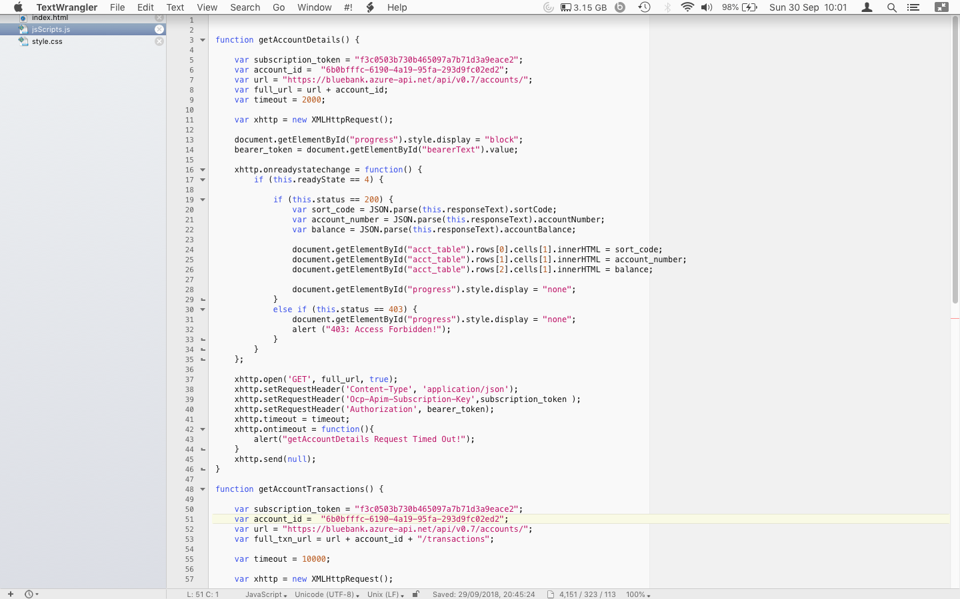
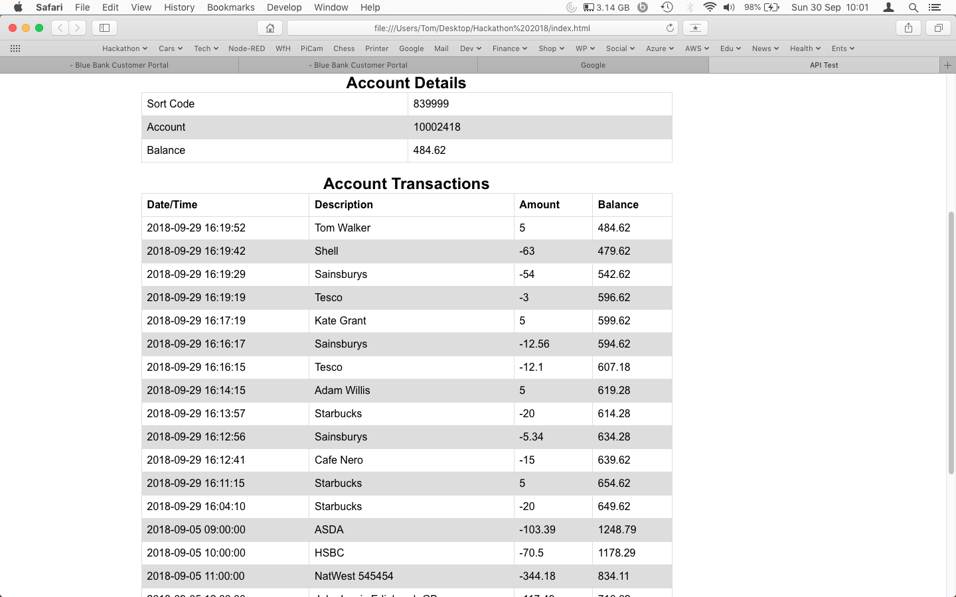
We’ve developed some code…..

